Slide 1
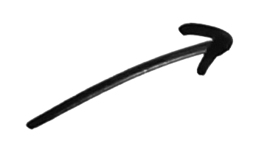
a framework for spiritual journey #1
intentional discipleship
seeking
openness
curiosity
5
the
thresholds
of conversion
trust
Notes:
Not rigid, sometimes a different order, repeat phases, etc. But it’s a framework. I really remember my seeking threshold twice…

Slide 2
The 5 THRESHOLDS of TRANSITION (from ‘not interested’ to ‘Intentional Discipleship’) 1. Trust (Initial trust, like feeling, BUT not an active personal faith): ‘ a person has a positive association with Jesus, the Church, a Christian believer or something identifiably Christian (a building, statue, idea, lifestyle, rule, etc. = this is what we call a BRIDGE OF TRUST). BUT trust is not the same as active personal faith.’ [In practice: Chatting with people to find common grounds and form a trusting relationship hugely helps, and also finding common interest that connect with the Church, Jesus, etc.] 2. Curiosity (spiritual curiosity): being intrigued by or desiring to know more about Jesus, his life, his teaching, or some aspect of the Christian faith. A person at this stage is not open to personal change. Curiosity is essentially passive. [Charisms of EVANGELISM, ENCOURAGEMENT can powerfully move others to open their lives to Christ, p. 93] 3. Openness (spiritual): openness to the possibility of personal and spiritual change. This is one of the most difficult transitions for a postmodern non-believer. Openness is not a commitment to change, it is simply openness to the possibility of change. [Charisms of TEACHING, WISDOM, can help remove obstacles to freely choosing personal faith and discipleship. P. 93] Pages 129-130

Slide 3
4. Spiritual seeking: At this stage the person is moving from essentially passive to actively seeking to know God who is calling him/her. ‘It is if you will, ‘’dating with a purpose’’, but not yet marriage.’ Seekers are asking: ‘are you the one to whom I will give myself.’ At this stage seekers engage in an urgent spiritual quest, seeking to know whether he or she can commit to Christ in his Church.’ [Charisms of HEALING, INTERCESSORY PRAYER, HOSPITALITY can enable the recipient to cooperate in Christ’s redemptive work, pp 93-94] 5. Intentional discipleship: this is the decision to ‘’drop the net’’, to make a conscious commitment to follow Jesus in the midst of his Church as an obedient disciple and to reorder one’s life accordingly.’ [Charisms of LEADERSHIP, ADMINISTRATION, MERCY and GIVING enable the recipient to cooperate in Christ’s redemptive work by healing society, p. 94] pages 129-130

Slide 4
Each transition to a new threshold is - a work of grace, empowered by the Holy Spirit - requires the energy of the individual - requires more and more profound choices of the individual who is making the journey p. 128

Slide 5
For example See John 9:1-38- ‘Blind man’s story’ - v.11: he speaks of Jesus as a man - v. 17: Jesus is a prophet for him - v. 33: He speaks of him as someone from God - v. 38: finally he calls him ‘Lord’, ie. he acknowledges Jesus to be God p.129

Slide 6
Keep in mind - At which threshold the person is does not depend on baptismal status or knowledge of faith (eg. some baptised and catechised Catholics are not even at the stage of simple trust (1st threshold), while some unbaptised are may even be intentional disciples without having been baptised. Can you think of anybody you know? p.129

Slide 7
Never accept a ‘label’, when you are helping someone to become an intentional disciple, eg. Catholic or agnostic, as these are likely to hide reality p.129
liberal
practicing Catholic
atheist
left
right
conservative

Slide 8
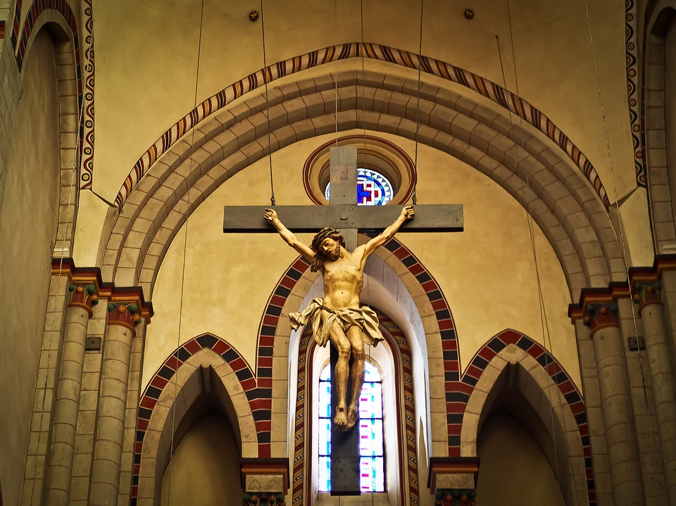
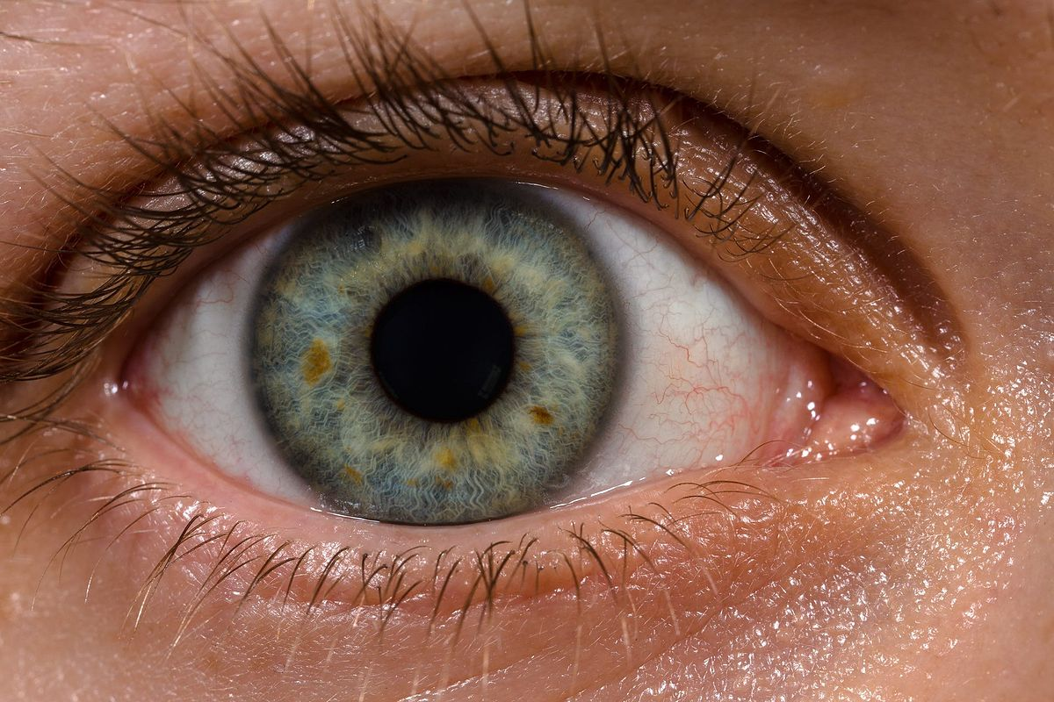
Look at Jesus, Church, etc. through the eyes of the person you are helping p.130

Slide 9
Nota bene: Those who are already disciples in another Christian tradition usually go through these same stages (5 thresholds) as they contemplate the possibility of becoming Catholics. p. 131

Slide 10
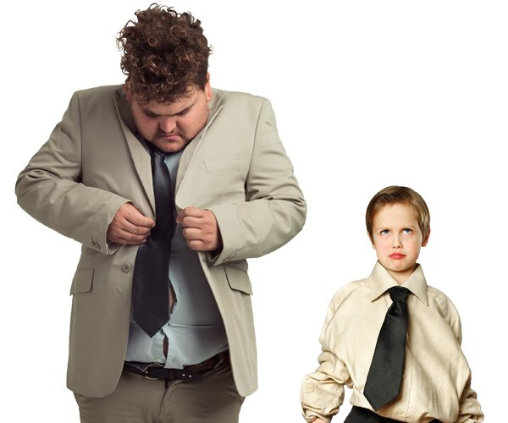
There is no ‘one-size-fits-all’ - people move from one stage to the next at different paces - others may stay stuck in one threshold for years others ping-pong back and forth between thresholds - some have great leaps, some relapses REMEMBER YOU ARE NOT IN CONTROL OF THIS PROCESS!! (P. 131)

Slide 11
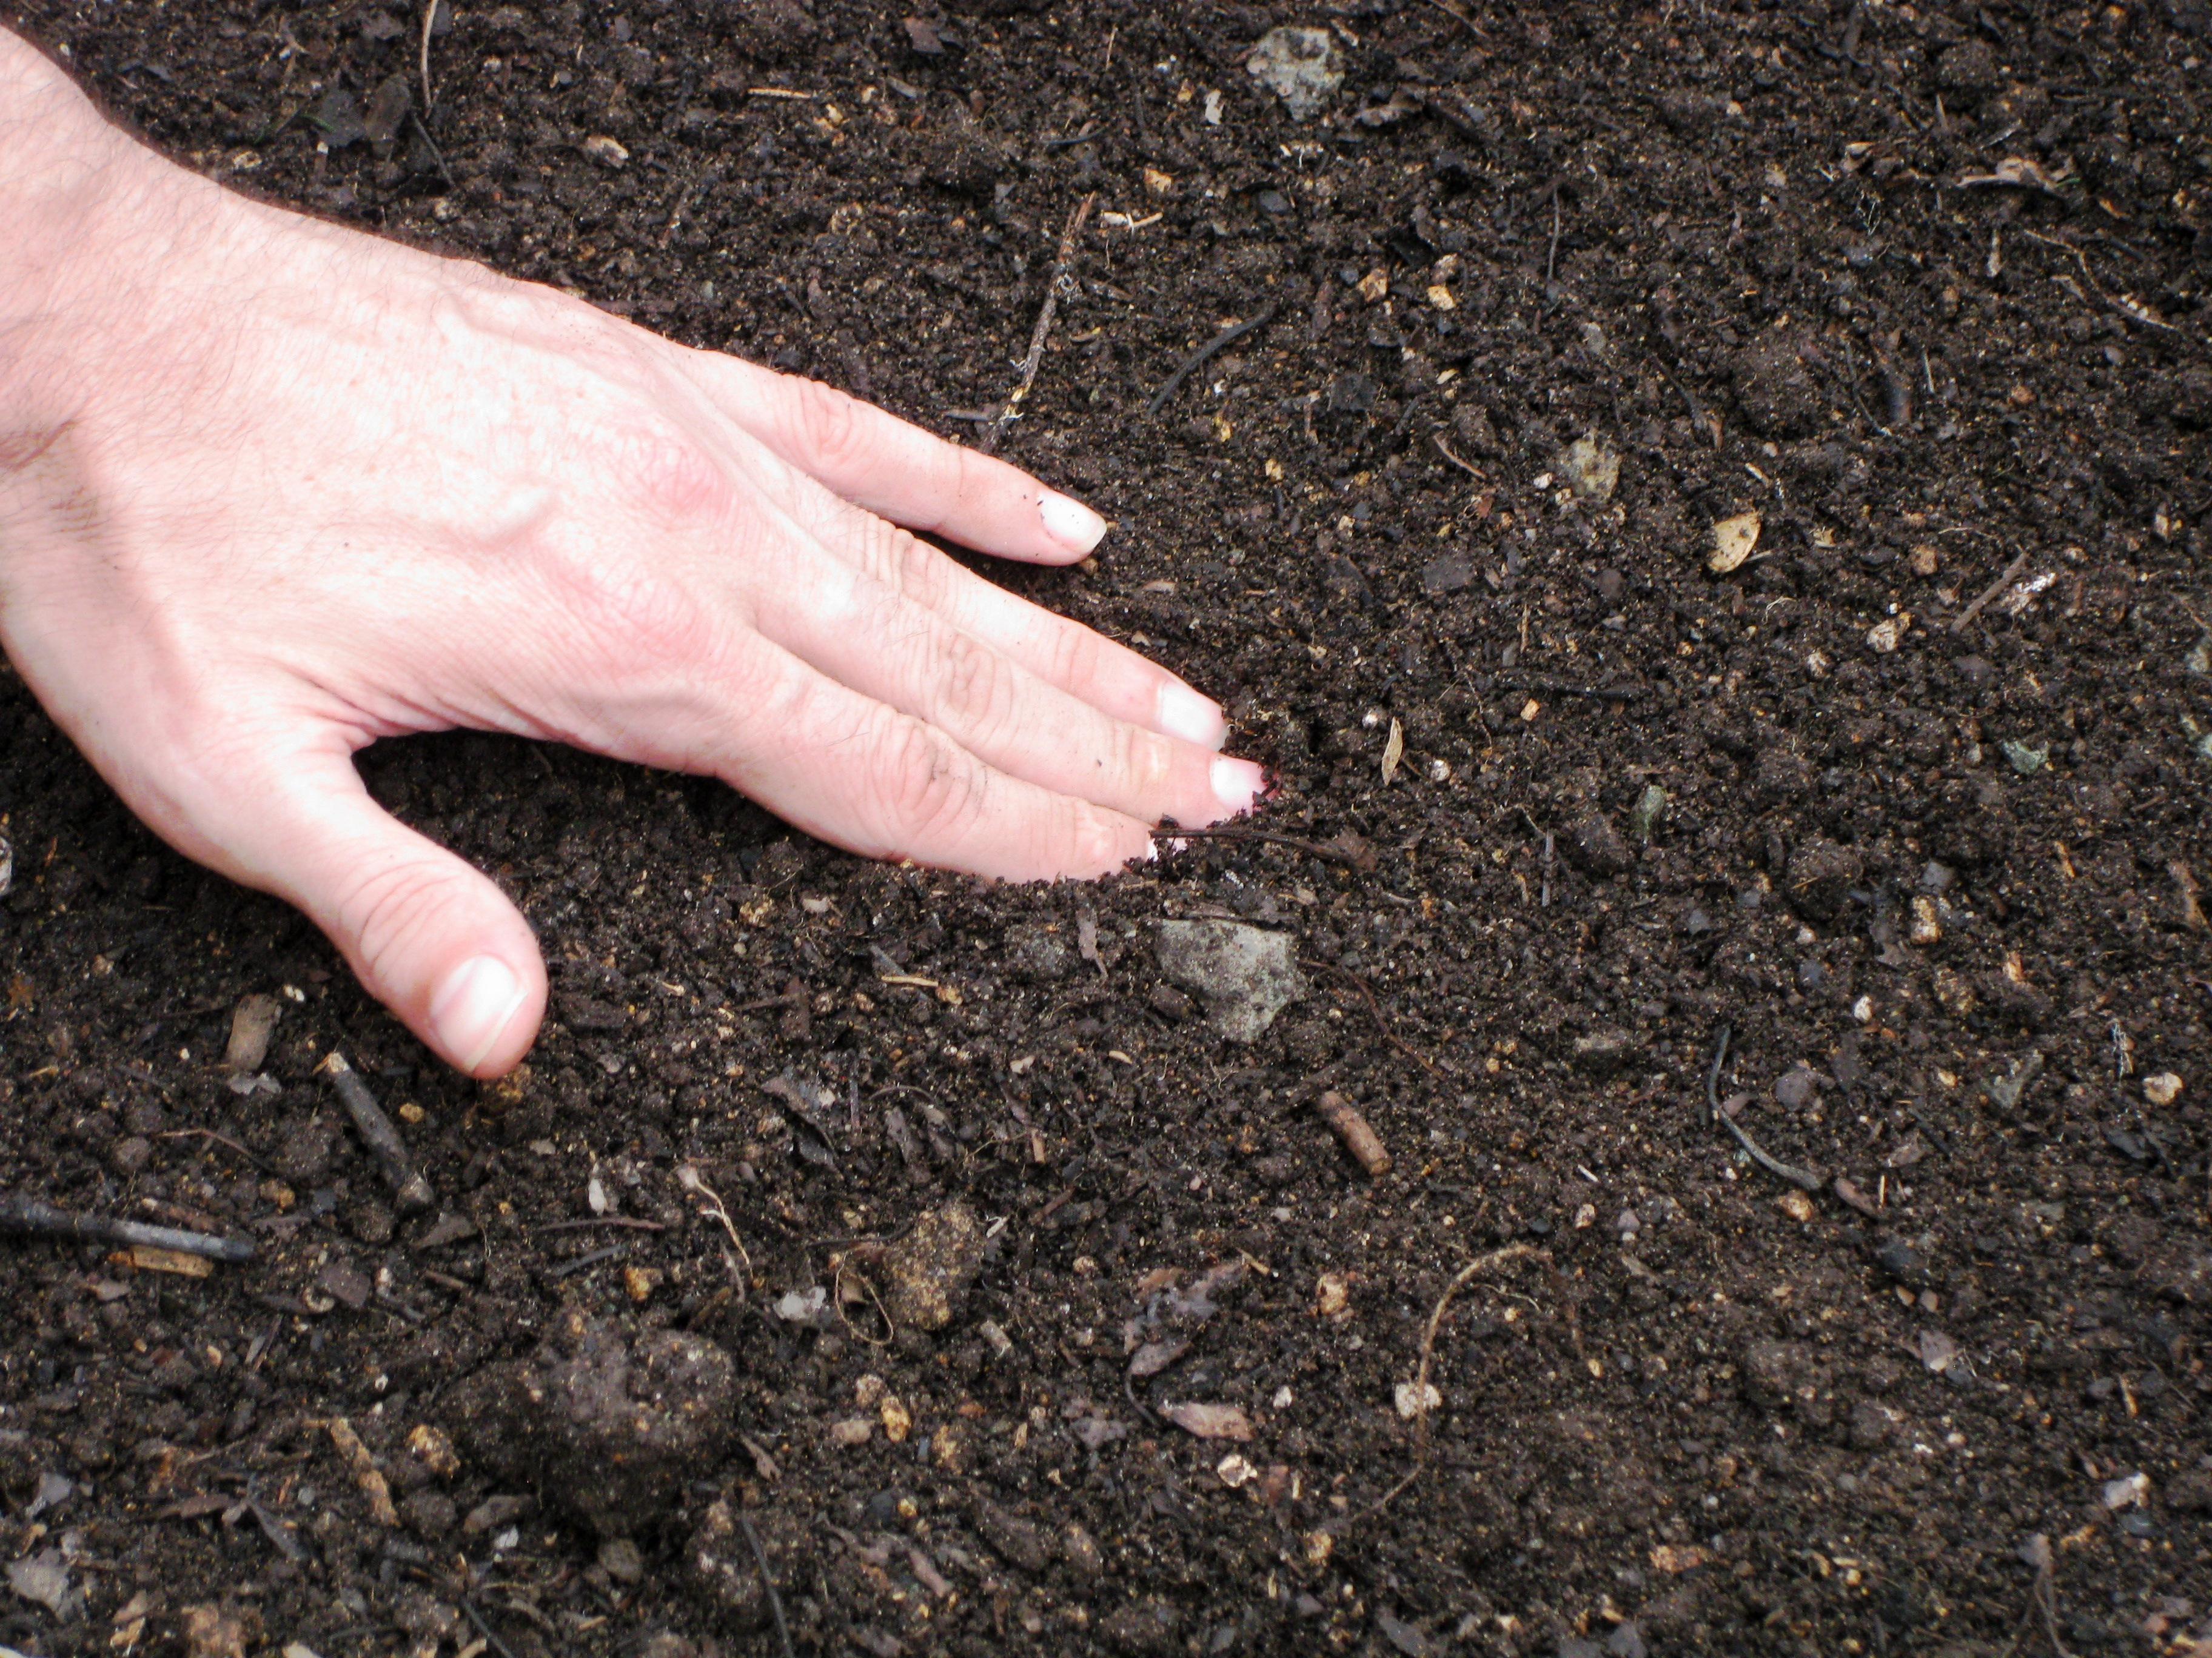
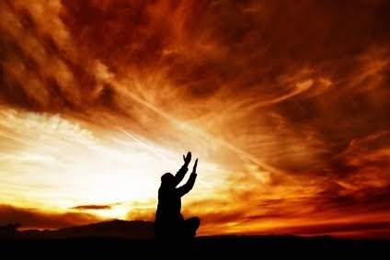
- Some people WILL NOT respond to our best efforts (see Jesus’ parable of the seeds in Mark 4: 14-19) - others WILL like the good soil ‘WE ARE DEALING WITH A MYSTERY OF A RELATIONSHIP THAT GOD HIMSELF IS INITIATING IN THE HUMAN HEART’ (Sherry Weddell) p. 132

Slide 12
NO PRESSURE, GUILT, ARGUMENT CLEVERNESS WILL BRING A PERSON TO FAITH, BUT THE HOLY SPIRIT WE CAN ONLY HELP WITH A RESPECTFUL APPROACH (p. 132)

Slide 13
SO DON’T GET IN THE WAY OF WHAT GOD IS DOING IN THE HUMAN HEART BUT HELP HIM!

Slide 14
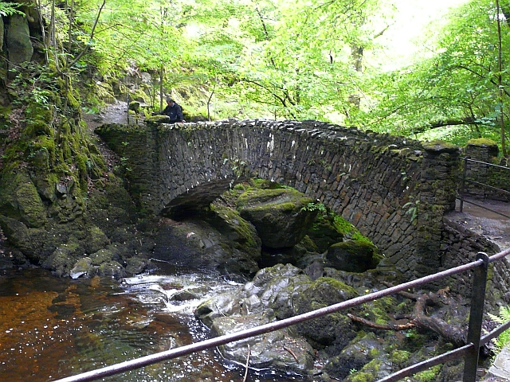
1st Threshold: Initial/basic trust - for some a cartoon can be an initial bridge of trust (eg. A Charlie Brown Christmas) - for someone with a different religious background Catholic school can be a bridge of trust SO FIRST BUILD A BRIDGE OF TRUST BETWEEN YOU AND THE PERSON YOU WANT TO HELP!

Slide 15
We earn basic trust ‘primarily through relationships: through the integrity, compassion, warmth and joy of our own life and faith’ /Sherry Weddell, p. 133/ Most active Catholics are at least at the threshold of basic trust.

Slide 16
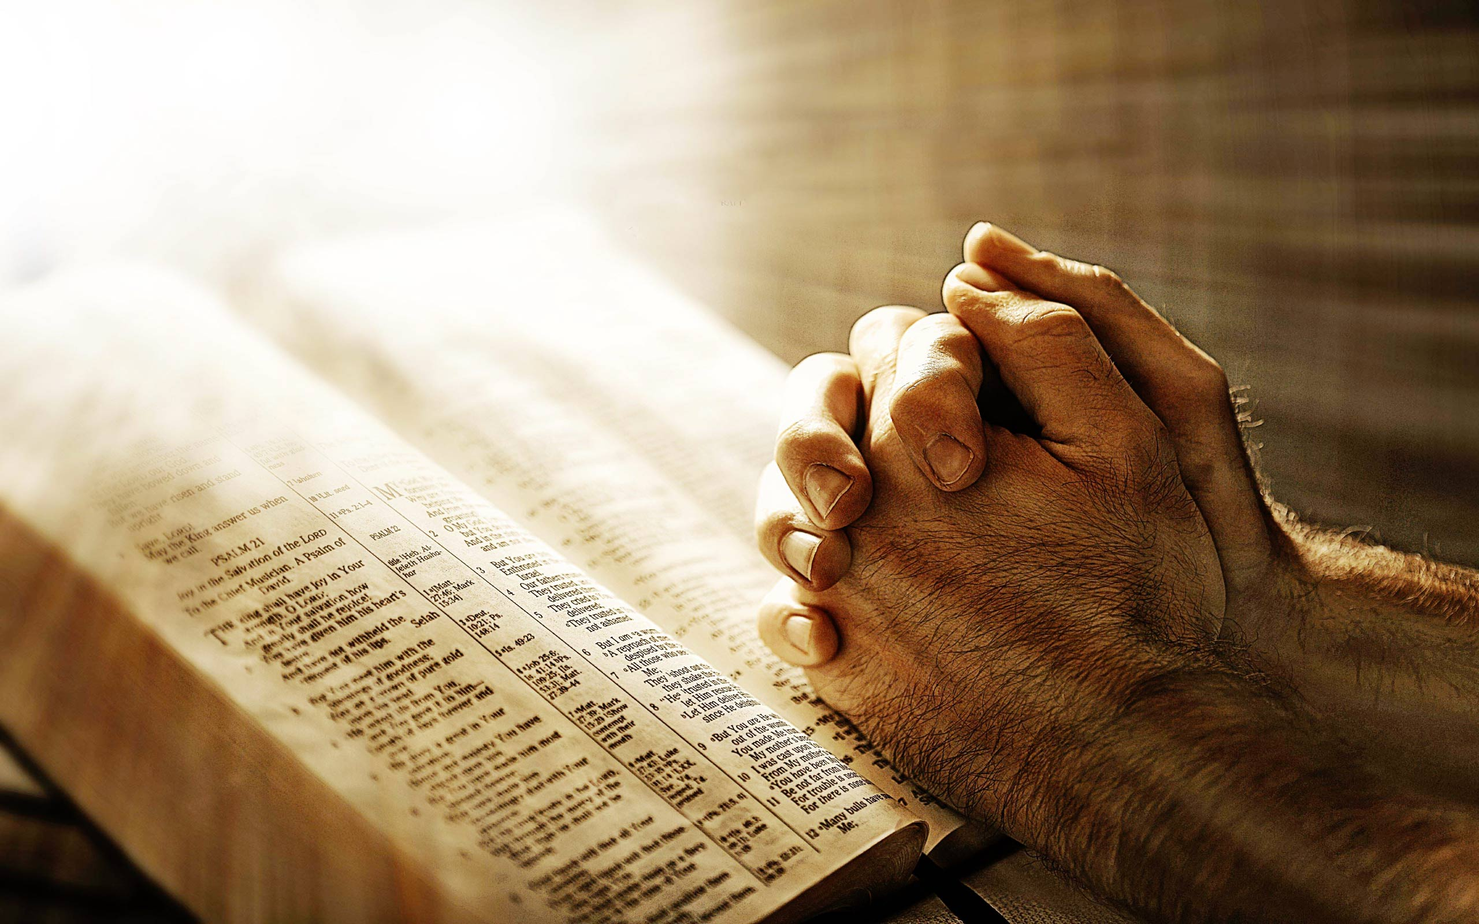
Practical advice: As you try to (re)build trust NOTA BENE!! PRAY AND WORK TO AVOID YOUR NATURAL REACTIONS TO THE DISTRUST DIRECTED AT YOU (ie, defensiveness, seeing yourself as a ‘victim’, and judging those who don’t trust you.) p.133

Slide 17
Distrust and trust can take startling forms among active Catholics: ‘ I trust God, but not the Church; I trust the Church, but not God.’ ‘I am devoted to Mary, but don’t trust any member of the Holy Trinity.’ p.134

Slide 18
‘Many don’t trust God or the Church, but they do trust a Christian in their life. Maybe they trust you. You may be the bridge that one day will lead them to a life-changing encounter with Christ.’ p.134

Slide 19
‘OUR JOB AT THIS THRESHOLD IS TO AFFIRM, STRENGTHEN, AND IF POSSIBLE BROADEN WHATEVER TRUST EXISTS IN THE PERSON TOWARD YOU AND/OR GOD.’

Slide 20
WE WILL NEVER EVANGELISE WHAT WE DO NOT LOVE ‘Trust cannot be built between people if the evangeliser regards the unevangelised with fear and disdain.’ /p.136/ I am a Christian not because it ‘makes sense’ or because someone sat down and diagrammed it for me. I am a Christian because I have been loved deeply and unconditionally by Christians. /p.137/

Slide 21
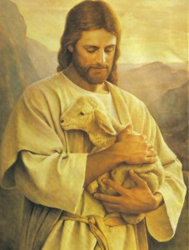
‘Evangelisation is not about us. It is about Jesus Christ, the Good Shepherd, seeking the lost sheep through us.’ /Sherry Weddell, p. 138/

